Slide 1

It supports: • N-dimensional array object • Broadcasting functions • Tools for integrating C/C++ and Fortran code • Useful linear algebra, Fourier transform, and random number capabilities
NUMPY
(NUMERICAL PYTHON)

Slide 2
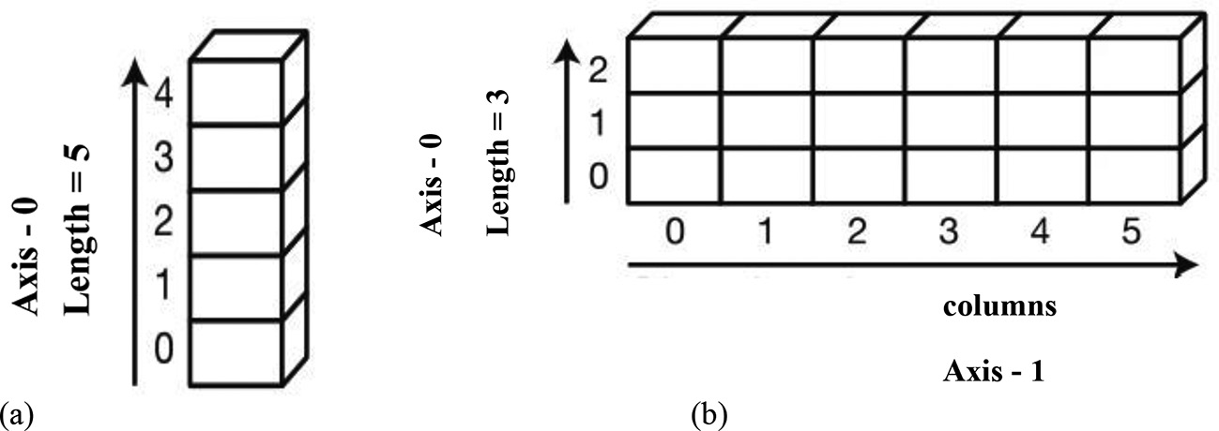
GENERAL IDEA
NumPy’s main object is the homogeneous multidimensional array. An array is a table of elements (usually numbers), all of the same type, indexed by a tuple of positive integers and represented by a single variable.
In NumPy arrays, the individual data items are called elements.
In NumPy, dimensions are called axes.
Each dimension of an array has a length which is the total number of elements in that direction.
The size of an array is the total number of elements contained in an array in all the dimension. The size of NumPy arrays are fixed; once created it cannot be changed again

Slide 3
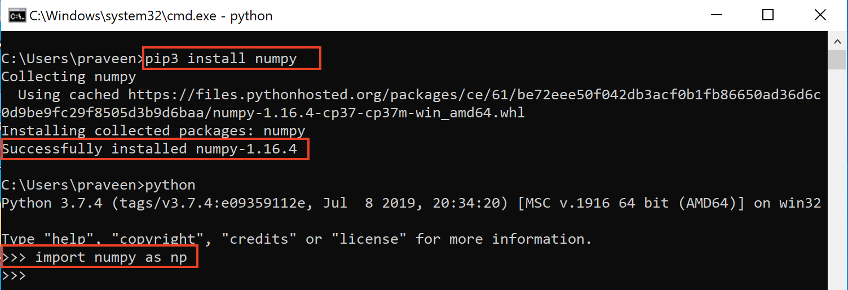
INSTALLING NUMPY

Slide 4
NumPy Arrays Creation Using array() Function
We can create a NumPy array from a regular Python list or tuple using the np.array() function. The type of the resulting array is deduced from the type of the elements.

Slide 5
TABLE OF ARRAY METHODS
ndarray Attributes Description
ndarray.ndim Gives the number of axes or dimensions in the array
ndarray.shape Gives the dimensions of the array. For an array with n rows and m
columns, shape will be a tuple of integers (n, m).
ndarray.size Gives the total number of elements of the array.
ndarray.dtype Gives an object describing the type of the elements in the array. One
can create or specify dtype’s using standard Python types.
Additionally, NumPy provides its own types like np.int32, np.int16,
np.float64, and others.
ndarray.itemsize Gives the size of each element of the array in bytes.
ndarray.data Gives the buffer containing the actual elements of the array.
Normally, we will not use this attribute because we will access the
elements in an array using indexing facilities.

Slide 6
NumPy Arrays Creation with Initial Placeholder Content
Often, the elements of an array are initially unknown, but its size is known. Hence, NumPy offers several functions to create arrays with initial placeholder content
These minimize the necessity of growing arrays, an expensive operation.

Slide 7
Numpy Array Creation Methods
ndarray Attributes Description
np.zeros() Creates an array of zeros
np.ones() Creates an array of ones
np.empty() Creates an empty array
np.full() Creates a full array
np.eye() Creates an identity matrix
np.random.random() Creates an array with random values
np.arange() Returns evenly spaced values within a given interval where start (a number and
optional) is the start of interval and its default value is zero, stop (a number) is
the end of interval, and step (a number and is optional) is the spacing between
the values and dtype is the type of output array.
The syntax for np.arrange is :: np.arange([start,]stop, [step,][dtype=None])

Slide 8
Numpy Array Creation Methods
Function Description
np.linspace() The syntax for linspace is,
numpy.linspace(start, stop, num=50, dtype=None)
Returns evenly spaced numbers over a specified interval where start is the
starting value of the sequence, stop is the end value of the sequence, and num(an integer and optional) is the number of samples to generate. Default is 50.Must be non-negative. The optional dtype is the type of output array.

Slide 9
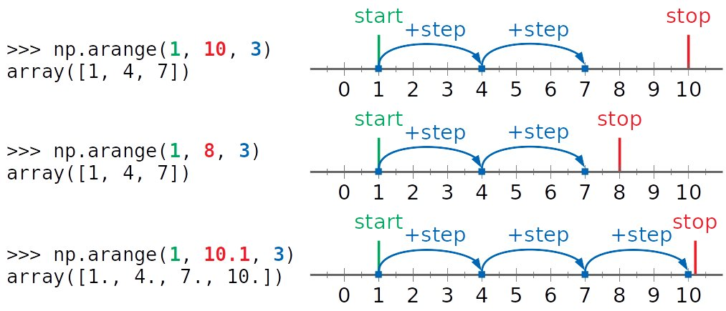

Slide 10
Integer Indexing, Array Indexing, Boolean Array Indexing, Slicing and Iterating in Arrays
One-dimensional arrays can be indexed, sliced, and iterated over, much like lists and other Python sequences.
For multi-dimensional arrays you can specify an index or slice per axis.

Slide 11



MULTIDIMENSIONAL ARRAY SLICING
0 1 2 3
b[:2, 1:3]
0
1
2
1 | 2 | 3 | 4
5 | 6 | 7 | 8
9 | 10 | 11 | 12
b[1,3]
b[2,1]

Slide 12
Lists vs numarray
A numpy array is a grid of values, all of the same type, and is indexed by a tuple of nonnegative integers.
A list is the Python equivalent of an array, but is resizeable and can contain elements of different types.
The most important benefits of using it are :
It consumes less memory.
It is fast as compared to the python List.
It is convenient to use.

